Slide 1


Hospital Database Project COMP-SCI: 470
Alexa Summers
Kari Jessip
Purva Patel
Thomas Tran
Notes:
Hello everyone, we are group 2. My name is Purva Patel and am today here with Alexa Summers, Kari Jessip and Thomas Tran to discuss our database project, that we built keeping in mind that the database would be used in a hospital- like setting. We all worked to develop database together. Each of us assumed every role.

Slide 2
Overview
About the project
ER diagram of the database
Schema diagram
Functional requirements of the database
Non-functional requirements of the database
Normalization
Sample SQL queries
Database limitations
Future scope
Demo
Problem with hospital database
Notes:
In today’s presentation, we are going to discuss what our project is, what real-world problem it addresses, er and schema diagram that we created for the database, functional and non-functional requirements, normalization that was done in database. Then, we are going to talk about some of the sql queries that we created. We are also going to present the limitations that our database has and its future scope along with the demo on how to use the database.

Slide 3
About the Hospital Project
This database contains information pertinent to patients, healthcare providers, and hospital administrators
Database contains several different views to help improve user interface and is protected with logins and passwords for security
Database contains stored procedures for added security and to help reduce screen time

Slide 4
Problems with current systems
Many Healthcare Database Systems are not connected to a central system, prohibiting the consistent electronic transfer of patient health data and records
Factors relating clinician burnout and Electronic Health Records (EHR)
Geared towards billing, not patient care
Information overload
Slow system response time
Inability to navigate system quickly
Notes:
The problem that this database hopes to solve is that in real world many Healthcare Database Systems are not connected to a central system, prohibiting the consistent electronic transfer of patient health data and records.
2) Factors relating clinician burnout and Electronic Health Records (EHR) are generally Geared towards billing, not patient care. There records have Information overload and have a Slow system response time. Also, it is hard to navigate through the system quickly for a clinician who is trying to access electronic health records.

Slide 5
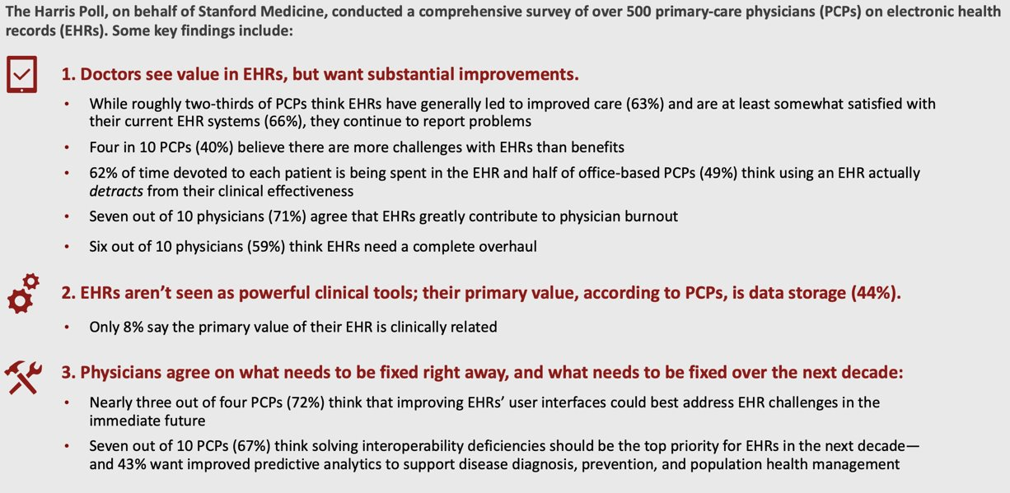
Stanford Medicine Poll on EHR's
Notes:
This slide shows how the problem discussed before is a real-world problem. Research from Stanford Medicine, conducted with The Harris Poll examined perceptions of Electronic Health Record systems among primary care physicians (PCPs). According to the poll, two major problems that the physicians want fixed in the EHR systems include- it’s user interface and it’s interoperability deficiencies that limits the system-wide information sharing.

Slide 6
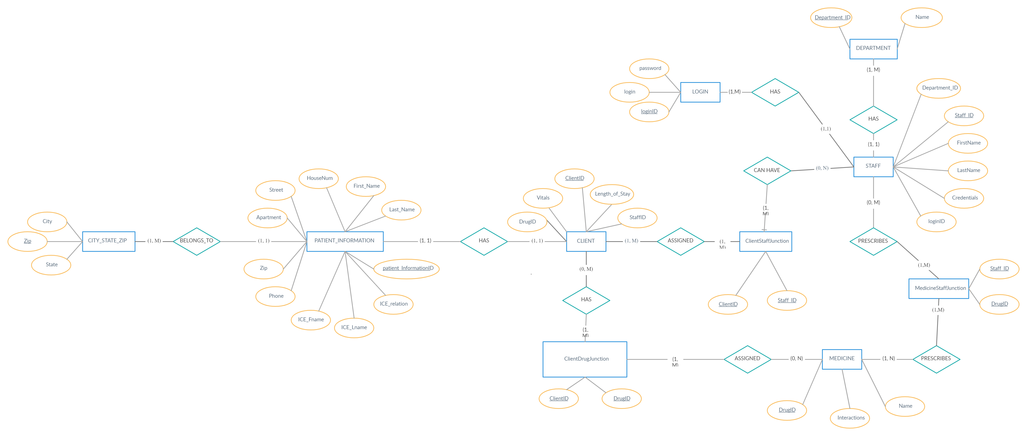
ER Diagram
Notes:
On the left we have general information about the patient and then discuss the junction tables and the complex queries.

Slide 7
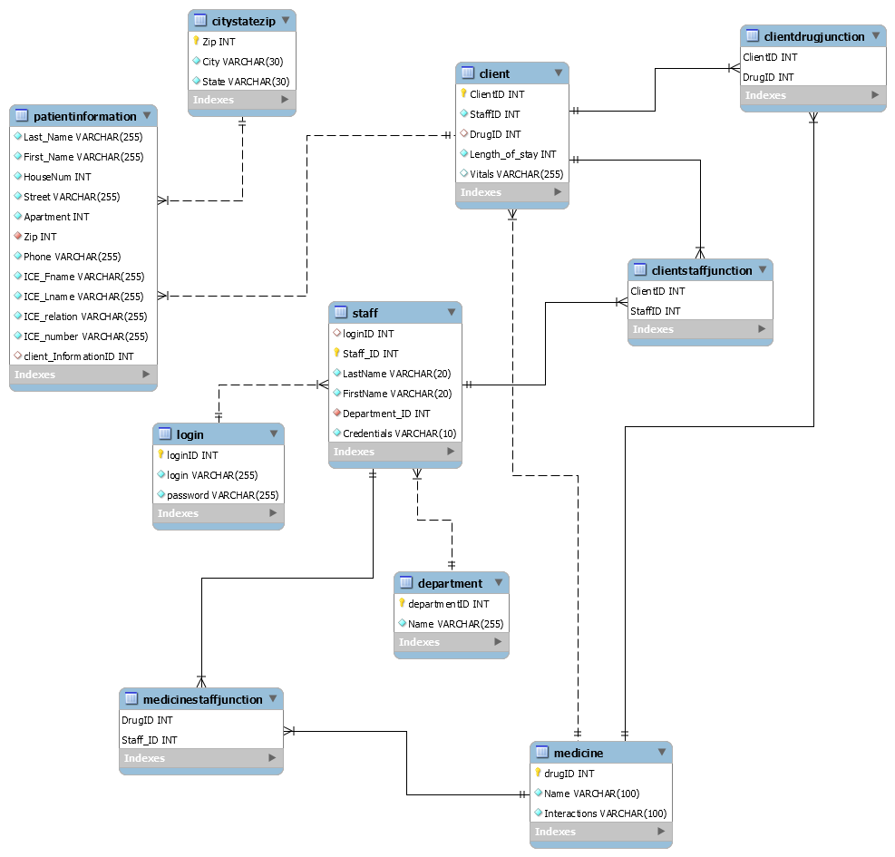
Schema Diagram

Slide 8

Requirements
Queries on doctor-patient relations, drugs taken/ prescribed by who/drug interactions.
Update patient information as the treatment goes along. Add new information in the tables as new patients arrive at the hospital.
Create, update, delete doctors being seen by the patient based on where the patient is on the course of hospital visit.
Create, update, delete tables containing information about hospital staff.
Each patient can be prescribed many drugs at a time (with drug interactions taken into consideration).
Each staff member can only have one login and one password at a time.

Slide 9
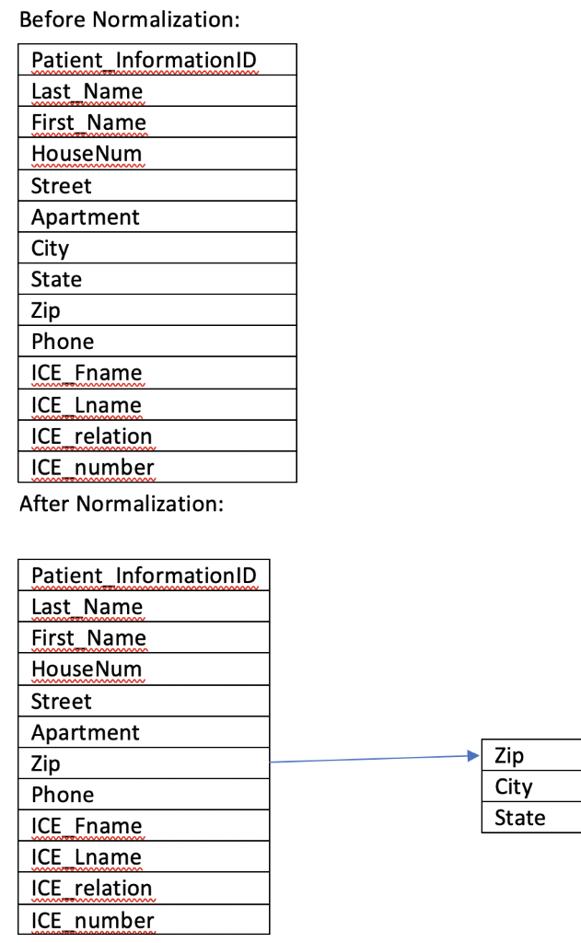
Normalization
Zip code normalization
Problem- The patient information table violated
the rule for 3NF.
Solution- The table was split to remove the
transitive dependency.

Slide 10
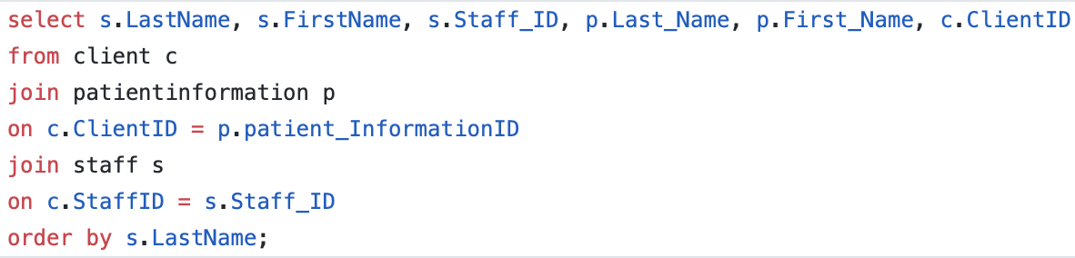
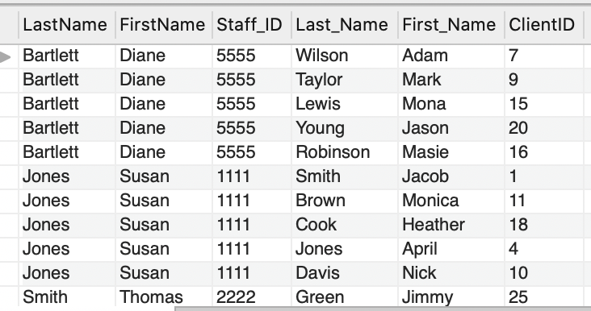
Example Queries
π LastName, FirstName, Staff_ID, Last_Name, First_Name, Staff_ID, ClientID
(STAFF⋈StaffID=Staff_ID CLIENT⋈_{clientID=patientinformation_id}
PATIENTINFORMATION)
Patient-Doctor relations ordered by Doctor Last Name

Slide 11
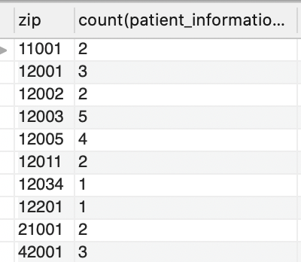
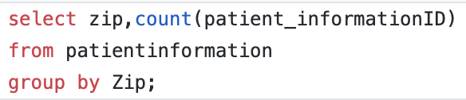
Example Queries Aggregate patients by zip code
_{Zip} 𝔉 _{COUNT} _{ClientID} CLIENT

Slide 12
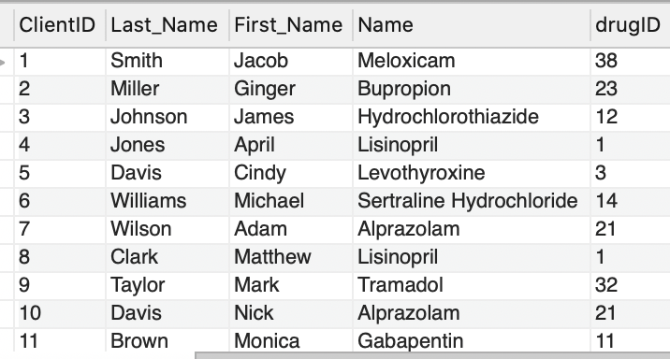
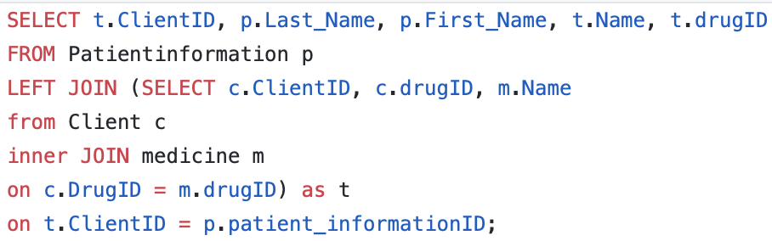
Example Queries Show list of medications that each patient is prescribed
π ClientID, Last_Name, First_Name, Name, drugID (PATIENTINFORMATION⋈ _{clientID=patientinformation_id}(π ClientID, drugID, Name(CLIENT⋈_{drugID=drugID} MEDICINE)))

Slide 13
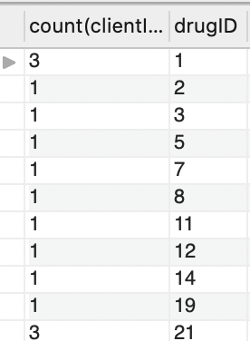
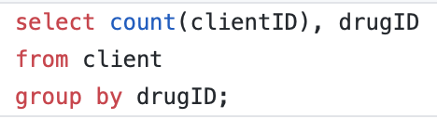
Example Queries Aggregate the number of patients prescribed a certain medication
_{DrugID} 𝔉 COUNT _{ClientID} CLIENT

Slide 14
Future for the Database
Would allow staff to share/coordinate patient care with colleagues
Would allow the patients to view their medical records and hospital stay schedule
User can create, update and delete information about the patients in the database
New staff information can also be inserted in the database
More stored procedures can be added depending on database user's demands
New views added for different triage staff
Add triggers to test constraints
Triggers to prevent unauthorized deletions
Add treatments, diagnosis, conditions etc.
More stored procedure (updates, inserts, and drops for specific records and attributes) and views (DBA, analyst, developer etc.)

Slide 15
Deficiencies
No triggers – Possibly implemented in the future
Lack of stored procedures for each table in the database that would take into account basic create, update, delete commands for all the tables
PHP does not reflect different login views
Interface is plain
Due to lack of working experience in a real hospital setting, there may be some relevant information missing in the database. Hence, this database is not a correct representation of a real-world hospital database

Slide 16

References
Kendall Bingham, MS, UMKC School of Computing and Engineering
www.nap.edu
www.ama-assn.org
www.med.stanford.edu
Fundamentals of Database Systems. Elmasri/Navath

